Slide 1
Decision Making and Branching

Slide 2

Overview
C++ decision making and branching statements:
1. if Statement
2. switch statement
i. Simple if statement:
if (test Expression)
{
statement-block;
}
statement_x;
ii. If else Statement:

Slide 3
Objectives
Nesting of if – else
else – if ladder

Slide 4
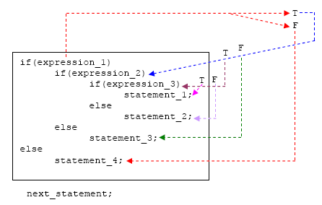
Nested if-else Statement
Syntax
Control Flow

Slide 5
if else nesting -Explanation
The if-else constructs can be nested (placed one within another) to any depth.
In this nested form, expression_1 is evaluated. If it is zero (FALSE-F), statement_4 is executed and the entire nested if statement is terminated;
if not (TRUE-T), control goes to the second if (within the first if) and expression_2 is evaluated. If it is zero, statement_3 is executed;
if not, control goes to the third if (within the second if) and expression_3 is evaluated. If it is zero, statement_2 is executed;
if not, statement_1 is executed. The statement_1 (inner most) will only be executed if all the if statement is true.
Syntax
Control Flow

Slide 6
Smallest among three numbers
#include <iostream.h>
#include <conio.h>
void main()
{
int a, b, c, result;
cout<<"Enter a, b & c\n";
cin>>a>>b>>c;
if (a < b)
if (a < c)
result = a;
else
result = c;
else
if (b < c)
result = b;
else
result = c;
cout<<“Smallest is"<< result;
}
Syntax
Control Flow

Slide 7
Another Example
……………
If (code==1)
{
if (balance > 5000)
bonus=0.5*balance;
else
bonus=0.2*balance;
}
else {
bonus=0.2*balance;
}
balance= balance +bonus;
…………..
Note: code =1→First part
code =0→Second part
balance and bonus are properly declared and initialized variables.
Syntax
Control Flow
For inputs
balance=5000
code = 1
Output: balance
6000
For inputs
balance=5001
code = 0
Output: balance
6001.2

Slide 8
Variation of previous example
……………
If (code==1)
if (balance > 5000)
bonus=0.5*balance;
else
bonus=0.2*balance;
balance= balance +bonus;
…………..
Note: else is linked to the closest non terminated if .
(i.e. here it is with inner if)
balance and bonus are properly declared and initialized variables.
Syntax
Control Flow
For inputs
balance=5000
code = 1
Output:
6000

Slide 9
Another variation
……………
If (code==1)
{
if (balance > 5000)
bonus=0.5*balance;
}
else
bonus=0.2*balance;
balance= balance +bonus;
…………..
(Here else is associated with outer if)
balance and bonus are properly declared and initialized variables.
Syntax
Control Flow
For inputs
balance=5000
code = 1
Output:
6000 or 5000 ?
Output:
5000 !

Slide 10
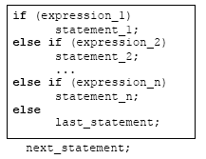
The else if Ladder
Syntax
Control Flow

Slide 11
else if ladder -Explanation
expression_1 is first evaluated. If it is TRUE, statement_1 is executed and the whole statement terminated and the next_statement is executed.
On the other hand, if expression_1 is FALSE, control passes to the else if part and expression_2 is evaluated.
If it is TRUE, statement_2 is executed and the whole system is terminated.
If it is False, other else if parts (if any) are tested in a similar way.
Finally, if expression_n is True, statement_n is executed; if not, last_statement is executed.
Note that only one of the statements will be executed others will be skipped.
The statement_n’s could also be a block of statement and must be put in curly braces.
Syntax
Control Flow

Slide 12
WAP Using else-if ladder to calculate grade for the marks entered
Syntax
Control Flow
marks grade
80-100 A
60-79 B
50-59 C
40-49 D
00-39 F

Slide 13
WAP Using else-if ladder to calculate grade for the marks entered
void main() {
char cgrade;
int imarks;
cout<<"enter marks";
cin>> imarks;
if(imarks>79)
cgrade = 'A';
else if (imarks>59)
cgrade = 'B';
else if (imarks>49)
cgrade = 'C';
else if (imarks>39)
cgrade = 'D';
else
cgrade = 'F';
cout<<"\n grade = "<<cgrade;
}
Syntax
Control Flow
For inputs
imarks= 46
grade = D
imarks= 64
grade = B
if(imarks>79)
cgrade = 'A';
else if (imarks>59)
cgrade = 'B';
else if (imarks>49)
cgrade = 'C';
else if (imarks>39)
cgrade = 'D';
else
cgrade = 'F';

Slide 14
True
False
Condition-1
True
False
statement-1
Condition-2
Syntax
Control Flow
False
True
statement-2
Condition-3
True
False
statement-3
Condition-n
statement-n
default statement
statement-x
else-if ladder Flow of control
next statement

Slide 15
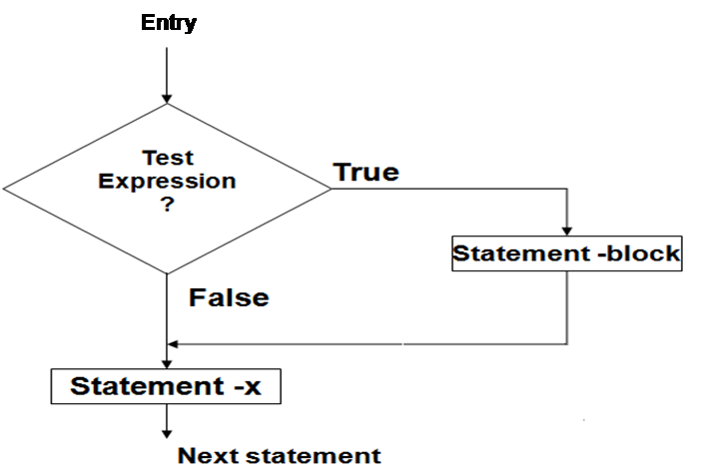
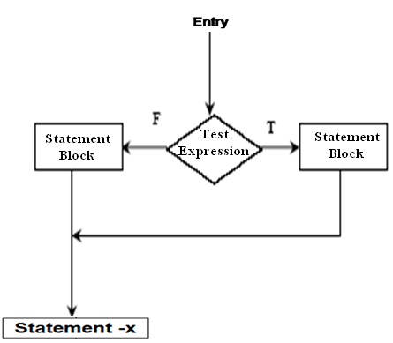
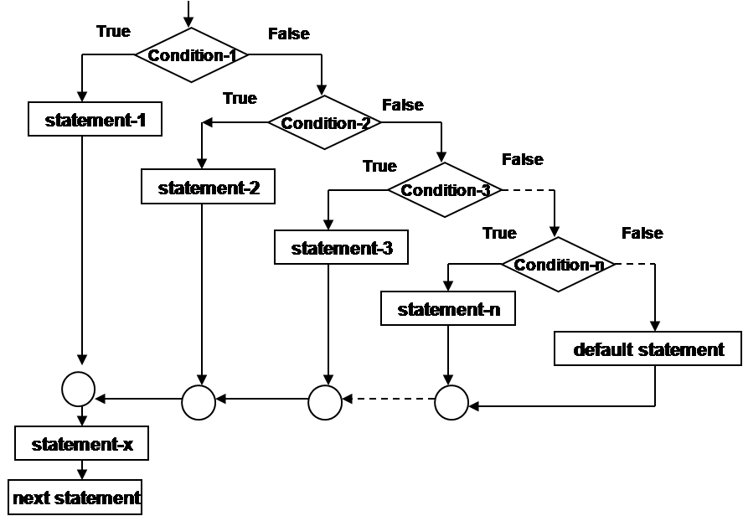
Flow of control in various control structures
Simple if
if -else
Syntax
else-if ladder

Slide 16
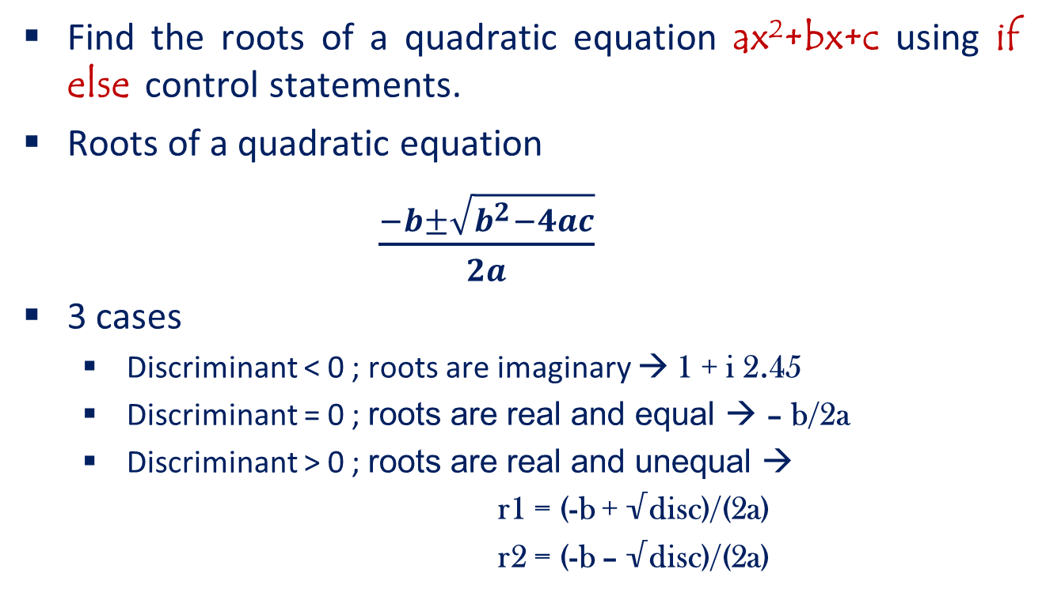
Problems…
Find the roots of a quadratic equation ax²+bx+c using if else control statements.
Roots of a quadratic equation
$\frac{−b±\sqrt{b^{2}−4ac}}{2a}$
3 cases
Discriminant < 0 ; roots are imaginary → 1 + i 2.45
Discriminant = 0 ; roots are real and equal → – b/2a
Discriminant > 0 ; roots are real and unequal →
r1 = (-b + √disc)/(2a)
r2 = (-b – √disc)/(2a)
Syntax
Control Flow

Slide 17
Find the roots of Quadratic equation using if-else statement
#include<math.h>
void main() {
float a,b,c,root1,root2,re,im;
cin>>a>>b>>c;
disc=b*b-4*a*c;
if (disc<0)
{
cout<<“imaginary roots\n”;
re= - b / (2*a);
im = pow(fabs(disc),0.5))/(2*a);
cout<<re<<“+ i”<< im;
cout<<re<<“-i”<< im;
}
else if (disc==0){
cout<<“real & equal roots”;
re=-b / (2*a);
cout<<“Roots are”<<re;
}
else { /*disc > 0*/
cout<<“real & distinct roots”;
cout<<“Roots are”;
root1=(-b + sqrt(disc))/(2*a);
root2=(-b – sqrt (disc))/(2*a);
cout<<root1<<“and”<<root2;
}
Syntax
Control Flow

Slide 18
More Problems …
WAP to find the commission on a salesman’s total sales. The commission on a salesman’s total sales is as follows:
a) If sales <100, then there is no commission.
b) If 100>= sales <=500, then commission = 10% of sales.
c) If sales > 500, then commission = 100+8% of sales above 500.
[Hint: Use else if statement ]
Syntax
Control Flow

Slide 19
More Problems…
if(sales<100) cout<<"\n No Commission”;
else if(sales>=100 && sales<=500) cout<<"\nCommission : “<< (sales*0.1);
else { comm=(sales-500)*0.08; cout<<“\nComm. : “<< (comm+100); } }
//Commission
#include< stdio.h> #include< conio.h> void main( )
{ int sales; float comm; cout<<“Enter the total sales:”; cin>>sales;
Syntax
Control Flow

Slide 20
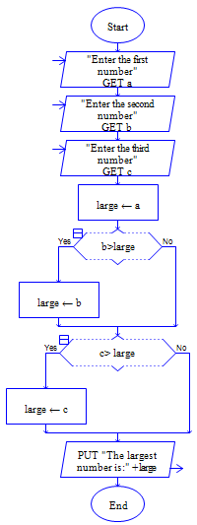
Find largest of 3 numbers
Algorithm: Largest of 3 numbers
Step 1: Input A,B,C
Syntax
Control Flow
Step 2: L←A
Step 3: If B>L then
L ←B
Step 4: if C>L Then
L←C
Note: Click on Case Study link for the Program
Step 5: Print L
Step 6: [End of Algorithm]
STOP

Slide 21
Syntax
Nested if else statement: else if ladder:
if (expression1)
if (expression2)
if (expression3)
statement1;
else
statement2;
else
statement3;
else
statement4;
next-statements;
Control Flow

Slide 22
Summary
Nesting if else statement
else if ladder
Syntax
Case studies
Control Flow
Do it yourself

Slide 23
The switch Statement
Switch is multiple–branching statement- based
on a condition, the control is transferred to one
of the many possible points.
The most flexible control statement in
selection structure of program control.
Enables the program to execute different
statements based on an expression that can
have more than two values. Also called
multiple choice statements.
Syntax
Control Flow

Slide 24
The switch Statement
General form:
switch(expression)
{
case value_1 : statement(s);
break;
case value_2 : statement(s);
break;
...
case value_n : statement(s);
break;
default : statement(s);
}
next_statement;
Control Flow

Slide 25
switch- Explanation
Evaluates the (expression) and compares its integer or character value
with the values following each case label.
1. If a match is found between (expression) and one of the values, execution is transferred to the statement(s) that follows the case label.
2. If no match is found, execution is transferred to the statement(s) following the optional default label.
3. If no match is found and there is no default label, execution passes to the first statement following the switch statement closing brace, the next_statement.
4. To ensure that only the statements associated with the matching template are executed, include a break statement where needed, which terminates the entire switch statement.
5. As usual the statement(s) can also be a block of code put in curly braces.
Syntax
Control Flow

Slide 26
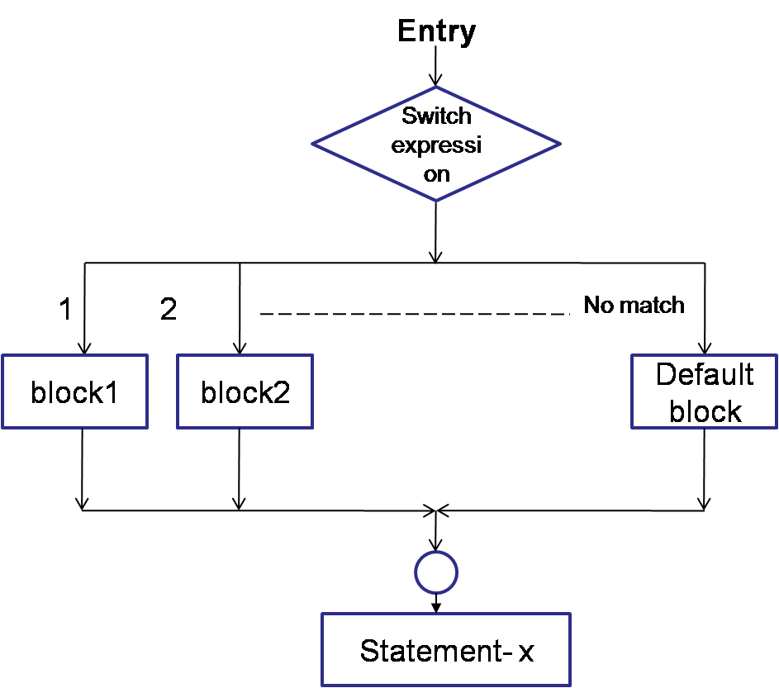
switch- control flow
Syntax
Control Flow

Slide 27
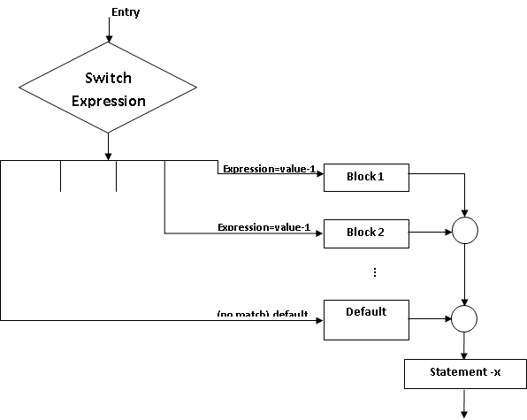
switch- flow of control
Syntax
Control Flow

Slide 28
switch- example
index=mark/10;
switch (index)
{
case 10:
case 9:
case 8: grade=‘A’;
break;
case 7:
case 6:
grade=‘B’;
break;
case 5:
grade=‘C’
break;
case 4:
grade=‘D’
break;
default: grade=‘F’;
break;
} cout<<grade;
Syntax
Control Flow

Slide 29
Arithmetical operations as per the choice – using switch statement
#include<iostream.h>
#include<conio.h>
void main()
{
clrscr();
char choice;
int a,b;
cout<<"enter two numbers\n";
cin>>a>>b;
cout<<"enter ur choice\n";
cout<<" + addition \n - subtration\n";
cout<<"* multiplication \n / division\n";
cin>>choice;
switch(choice)
{
case '+' :
cout<<a+b; break;
case '-' :
cout<<a-b; break;
case '*' :
cout<<a*b; break;
case '/' :
cout<<a/b; break;
default:
cout<<"invalid choice";
}
getch();
}
Syntax
Control Flow

Slide 30
Some guidelines for writing switch case statements
Order the cases alphabetically or numerically – improves readability. Put the normal cases first ; put the exceptional cases later. Order cases by frequency:-put the most frequently executed cases first and the least frequently used cases later. Use default case to detect errors and unexpected cases [user friendly messages].
Syntax
Control Flow

Slide 31
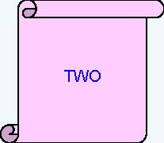
What is the output of the following code snippet?
int iNum = 2;
switch(iNum){
case 1:
cout<<“ONE”; break;
case 2:
cout<<“TWO”; break;
case 3:
cout<<“THREE”;break;
default:
cout<<“INVALID”;break;
}
Syntax
Control Flow

Slide 32
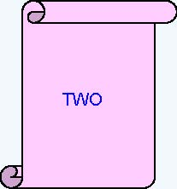
What is the output of the following code snippet?
iNum = 2;
switch(iNum) {
default:
cout<<“INVALID”;
case 1:
cout<<“ONE”;
case 2:
cout<<“TWO”;
break;
case 3:
cout<<“THREE”;
}
Syntax
Control Flow

Slide 33
What is the output of the following code snippet?
switch (iDepartmentCode){
case 110 : cout<<“HRD”;
case 115 : cout<<“IVS”;
case 125 : cout<<“E&R”;
case 135 : cout<<“CCD”;
}
Assume iDepartmentCode is 115
find the output ?
Syntax
Control Flow
IVSE&RCCD

Slide 34
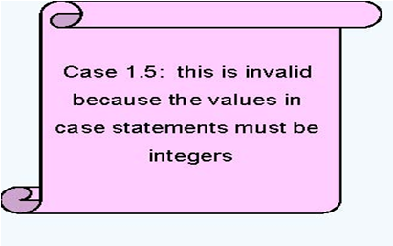
What is the output of the following code snippet?
int iNum = 2;
switch(iNum) {
case 1.5:
cout<<“ONE AND HALF”;
break;
case 2:
cout<<“TWO”;
case ‘A’ :
cout<<“A character”;
}
Syntax
Control Flow

Slide 35
What is the output of the following code snippet?
unsigned int iCountOfItems = 5;
switch (iCountOfItems) {
case iCountOfItems >=10 :
cout<<“Enough Stock” ; break;
default :
cout<<“Not enough stock”; break;
}
Error: Relational Expressions cannot be used in switch statement
Syntax
Control Flow

Slide 36

An Example – switch case
char ch=‘a’;
switch(ch)
{
case ‘a’ : cout<<“Vowel”; break;
case ‘e’ : cout<<“Vowel”; break;
case ‘i’ : cout<<“Vowel”; break;
case ‘o’ : cout<<“Vowel”; break;
case ‘u’ : cout<<“Vowel”; break;
default: cout<<“Not a Vowel”;
}
char ch=‘a’;
switch(ch)
{
case ‘a’ :
case ‘e’ :
case ‘i’ :
case ‘o’ :
case ‘u’ :
cout<<“Vowel”; break;
default :
cout<<“Not a vowel”;
}
Syntax
Control Flow

Slide 37
Flow of control in various control structures
Simple If
If -else
Syntax
Else-if ladder
Switch

Slide 38
Find the roots of Quadratic equation using switch statement
#include<math.h>
float a,b,c,re,im,root1,root2,disc;
int d;
cout<<"\nEnter the values of a, b & c:";
cin>>a>>b>>c;
disc=b*b – 4*a*c;
cout<<"\nDiscriminant= "<<disc;
if(disc<0) d=1;
if(disc==0) d=2;
if(disc>0) d=3;
Syntax
Control Flow

Slide 39
Find the roots of Quadratic equation using switch statement
switch(d) {
case 1:
cout<<"\nThe roots are imaginary.\n";
re=-b/(2*a);
im=pow( – disc ,0.5)/(2*a);
cout<<"\nRoot1= "<<re<<" + i " <<im;
cout<<"\nRoot2= "<<re<<" - i "<<im;
break;
case 2:
cout<<"\nRoots are real and equal.\n";
root1=-b/(2*a);
cout<<"Root1 = Root2 = "<<root1;
break;
Syntax
Control Flow

Slide 40
Find the roots of Quadratic equation using switch statement
case 3:
cout<<"\nRoots are real and unequal.\n";
root1=(– b + sqrt(disc))/(2*a);
root2=(– b - sqrt(disc))/(2*a);
cout<<"\nRoot1 = "<<root1;
cout<<"\nRoot2 = "<<root2;
break;
} // end of switch
} //End of Program
Syntax
Control Flow

Slide 41
Summary
Syntax
Control Flow
MCQs
switch statement
Syntax
Examples
Application

